Slide 1
PRESENTED BY : Sanskruti duche

Slide 2
Simple calculator using python

Slide 3
About the project
For those who do not know, a calculator is a basically a program on a computer that simulates the behavior of any hand-held calculator useful for performing Mathematical Calculations. It is a very basic device used in our everyday lives. Now all the smartphones also have a calculator in them.
While creating any GUI Application there are mainly two steps:
First step to create a User Interference .
Second step is the most important one in this, to add functionalities to the GUI.

Slide 4
Main Components •Tkinter: Python library used for building graphical user interfaces. •Key Components in Tkinter: •Root Window: The main container for the app (root = tk.Tk()). •Text Widget: Displays the current calculation and result (tk.Text). •Buttons: Used for input and triggering actions (tk.Button).

Slide 5
Code Explanation: Functionality 1. Global Variables: • calculation: Stores the ongoing arithmetic expression as a string. 2. Functions: • `add_to_calculation(symbol): • Appends user input (symbols) to the calculation. • Updates the display widget dynamically. • `evaluate_calculation(): • Evaluates the arithmetic expression using Python’s eval() function. • Handles errors like invalid input with exception handling. • `clear_field(): • Clears the calculation and resets the display.

Slide 6
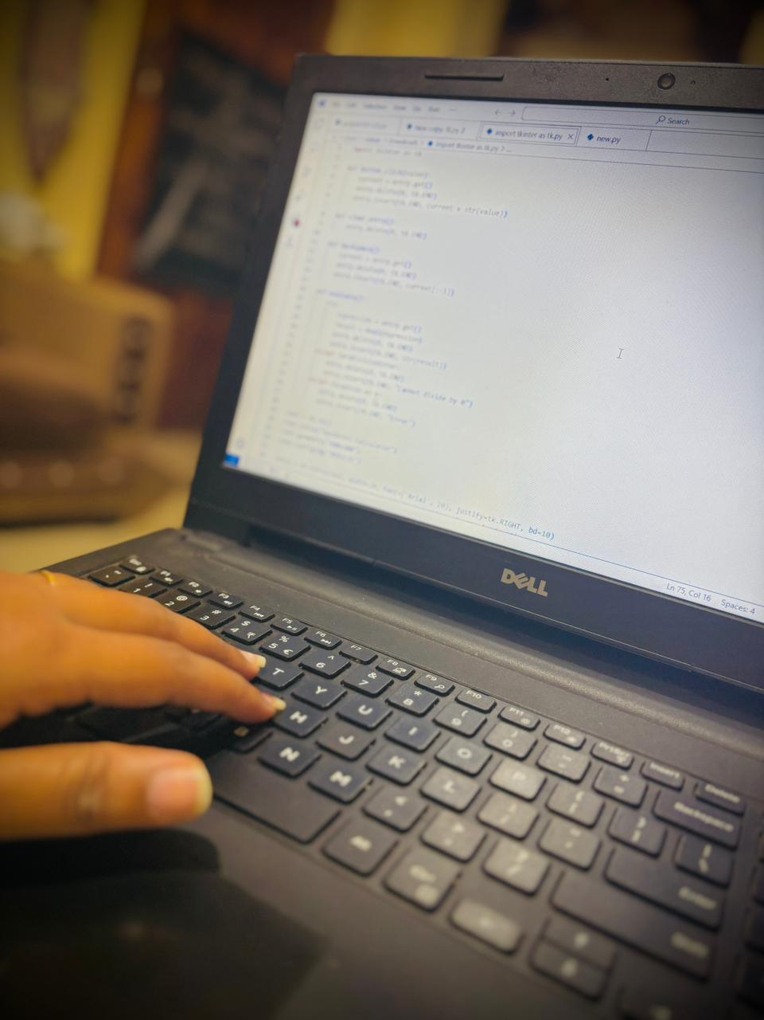
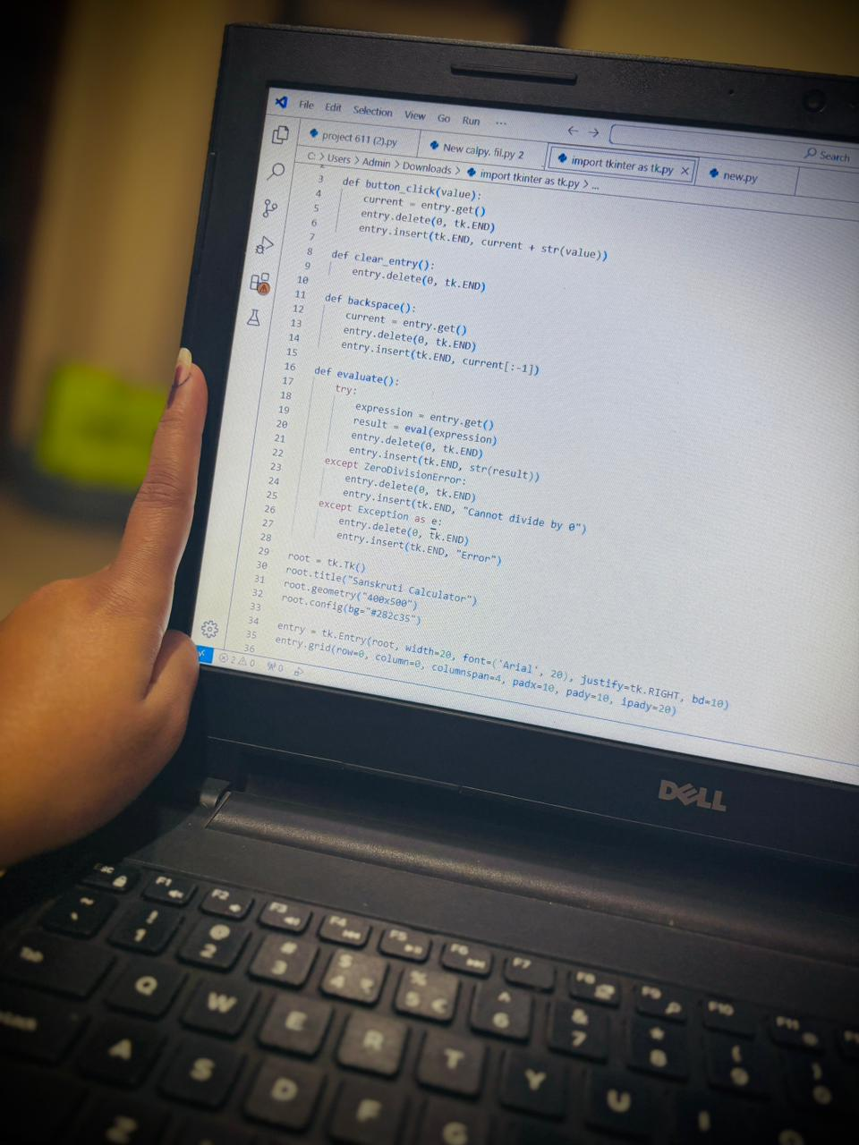
Code :

Slide 7
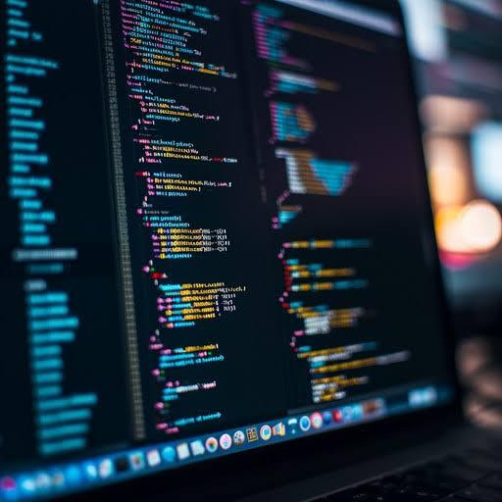
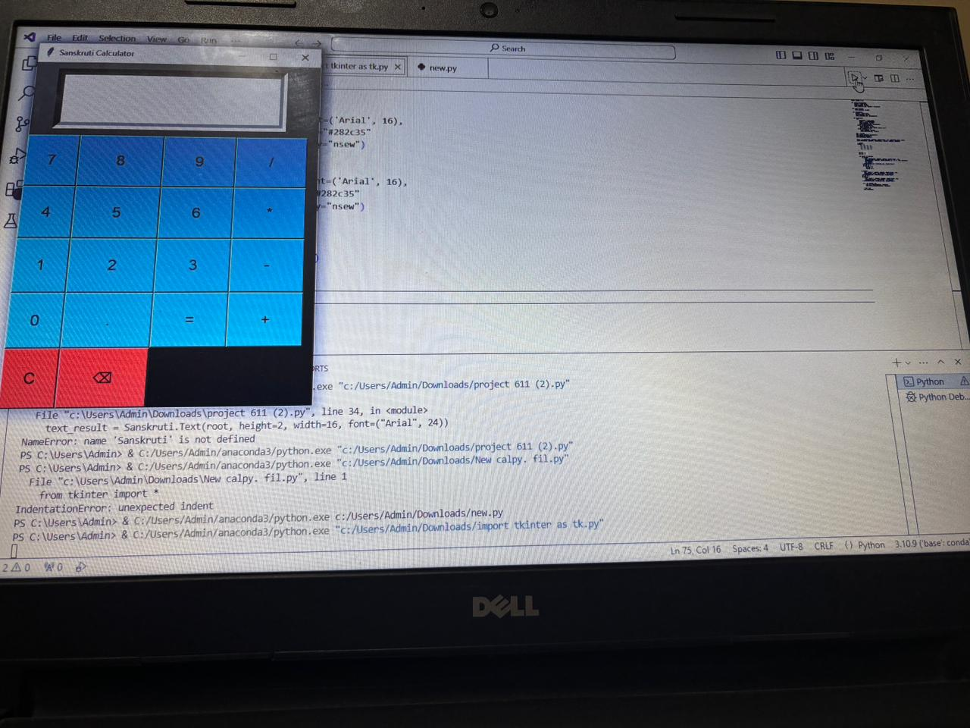
Demonstration
Live Demo:
Show how the calculator handles inputs, evaluates results, and resets on demand.

Slide 8
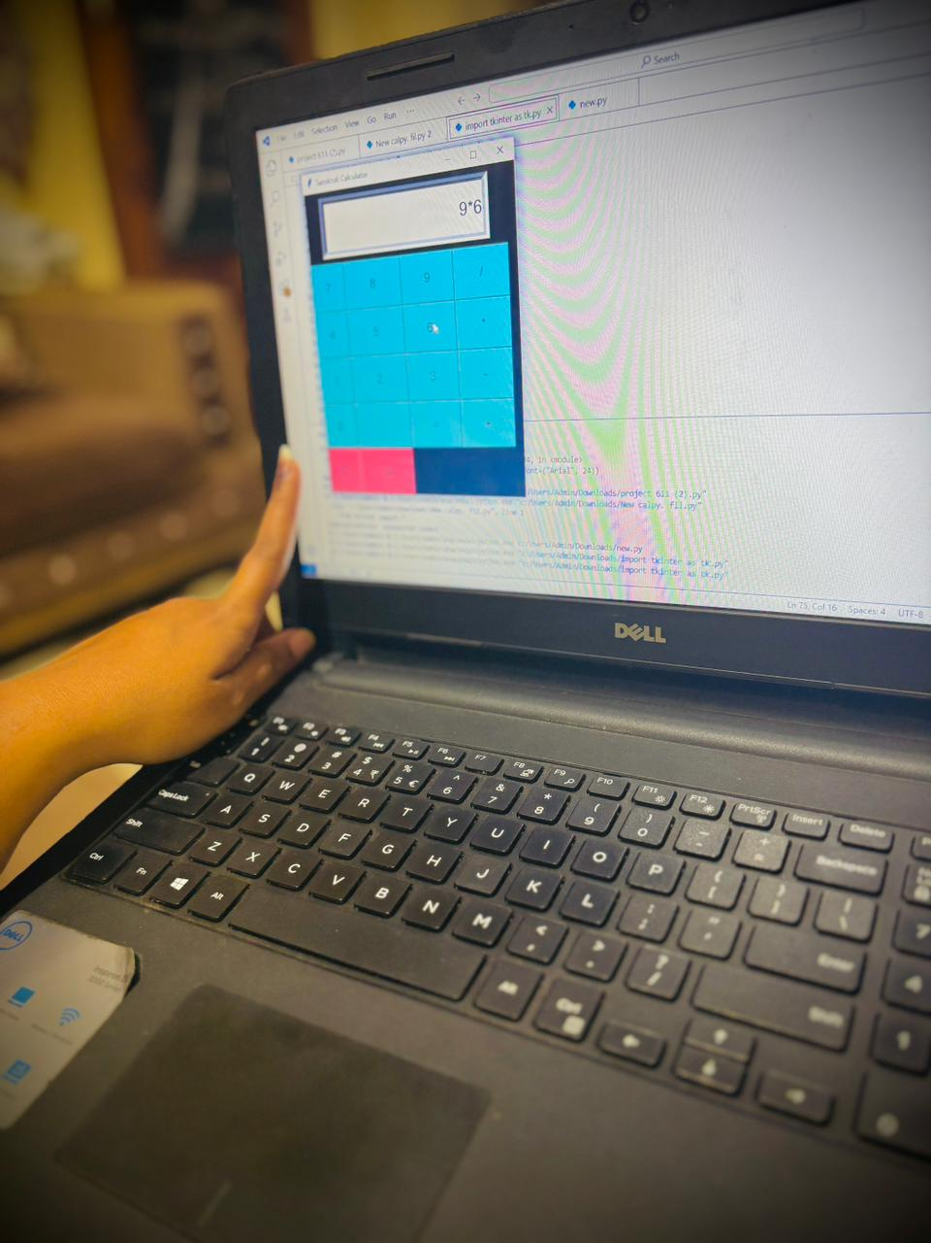
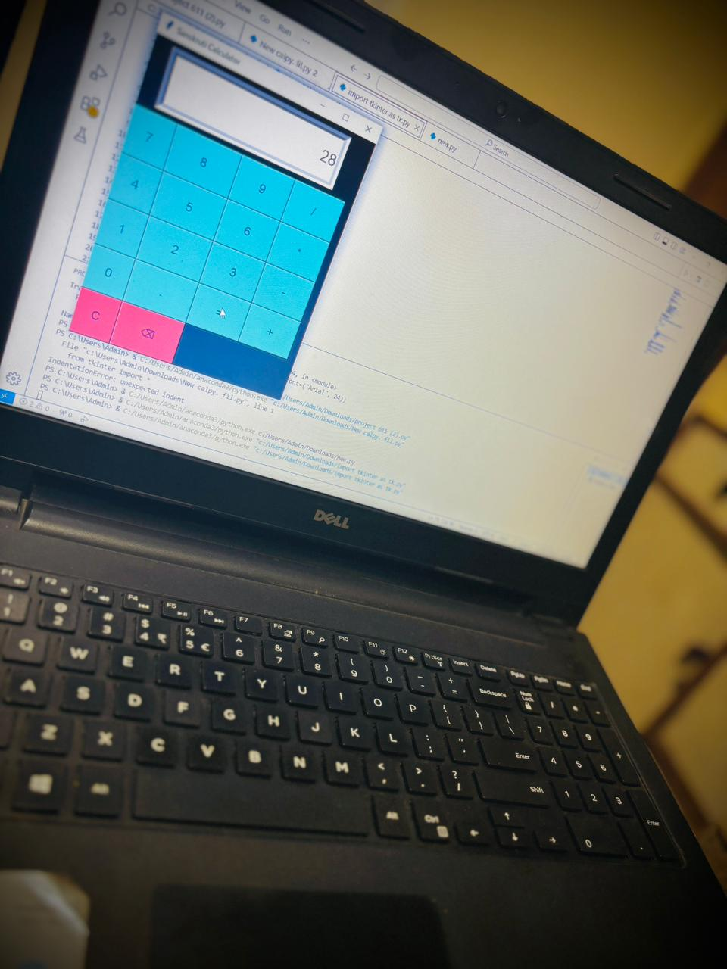
Features/Outputs: • Perform addition, subtraction, multiplication, and division. • Clear and reset functionality. • Dynamic display of results and calculations.

Slide 9
Enhancements
• Add support for advanced operations (square root, powers).
• Enhance error handling for invalid expressions.
• Improve UI/UX with themes and larger layouts.

Slide 10
Conclusion
• Takeaway: A simple yet functional GUI calculator demonstrates the power of Python and Tkinter.
• Further Learning: Explore Tkinter to create more advanced and user-friendly applications.

Slide 11
Thank you

